Slide 1
Model Evaluation
Linden Lu

Slide 2
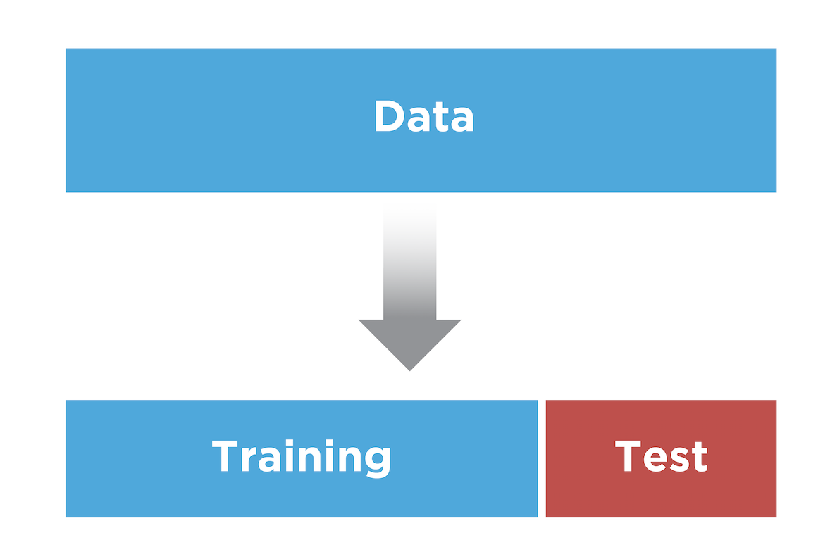
Dataset Splitting

Slide 3

CRISP-DM
© 2012 Kenneth Jensen / CC BY-SA 3.0 / http://tinyurl.com/yxuuhnyx

Slide 4
Model Evaluation
Regression evaluation metrics
Classification evaluation metrics
Case study

Slide 5
Regression Evaluation Metrics
Linden Lu

Slide 6
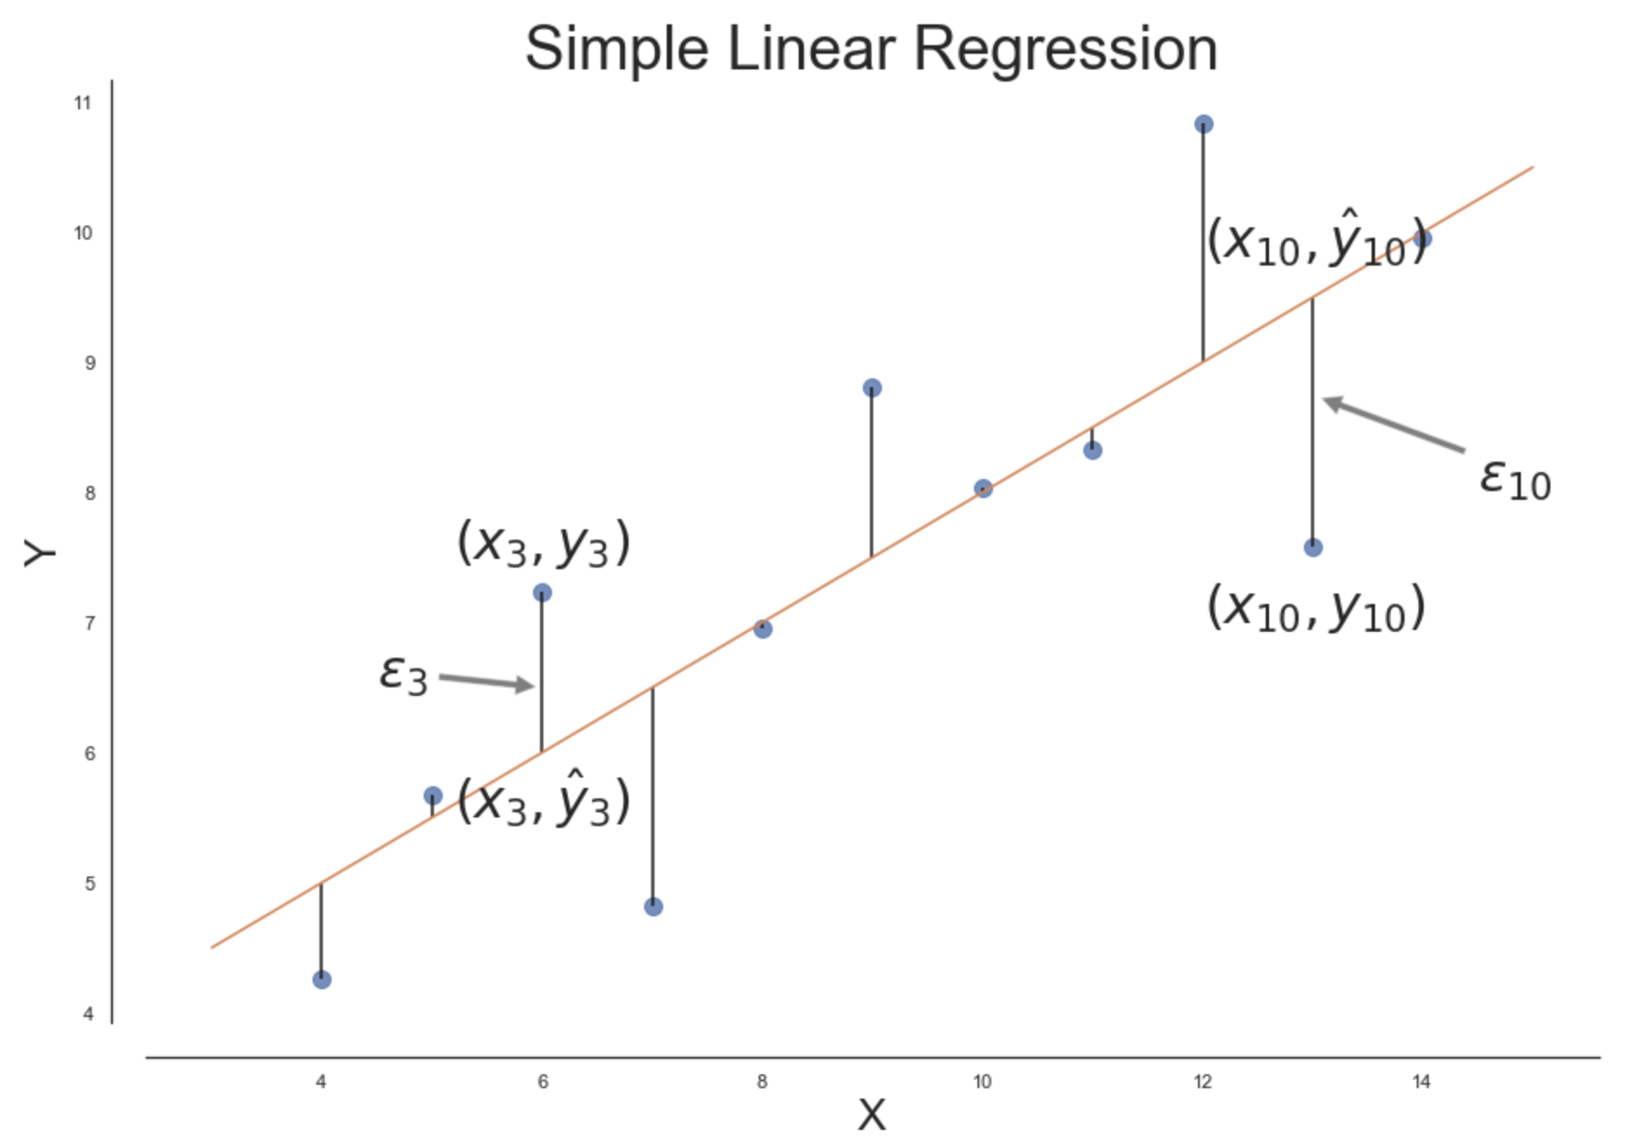
Regression Evaluation
Evaluation Metrics for Regression
Mean Absolute Error (MAE)
Mean Squared Error (MSE)
Root Mean Squared Error (RMSE)
R-squared (𝑅2)

Slide 7
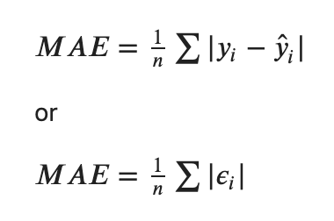
Mean Absolute Error (MAE)

Slide 8
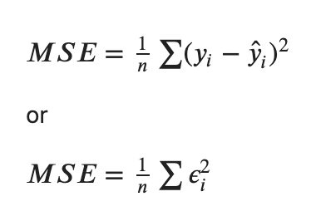
Mean Squared Error (MSE)

Slide 9
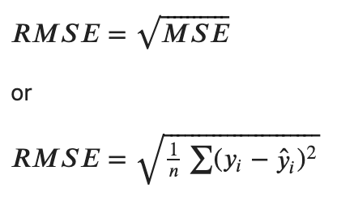
Root Mean Squared Error (RMSE)

Slide 10
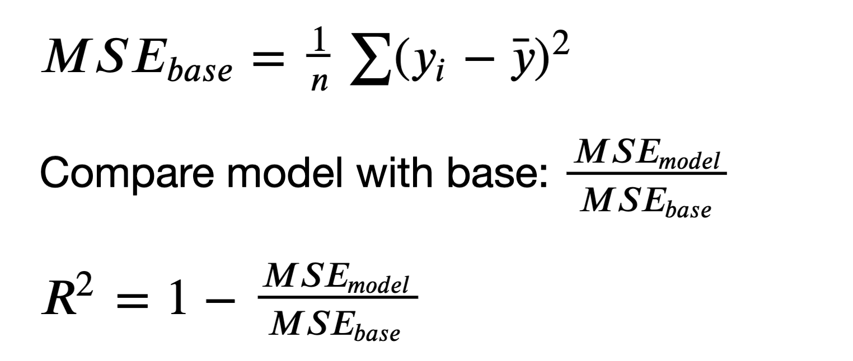
R-squared

Slide 11
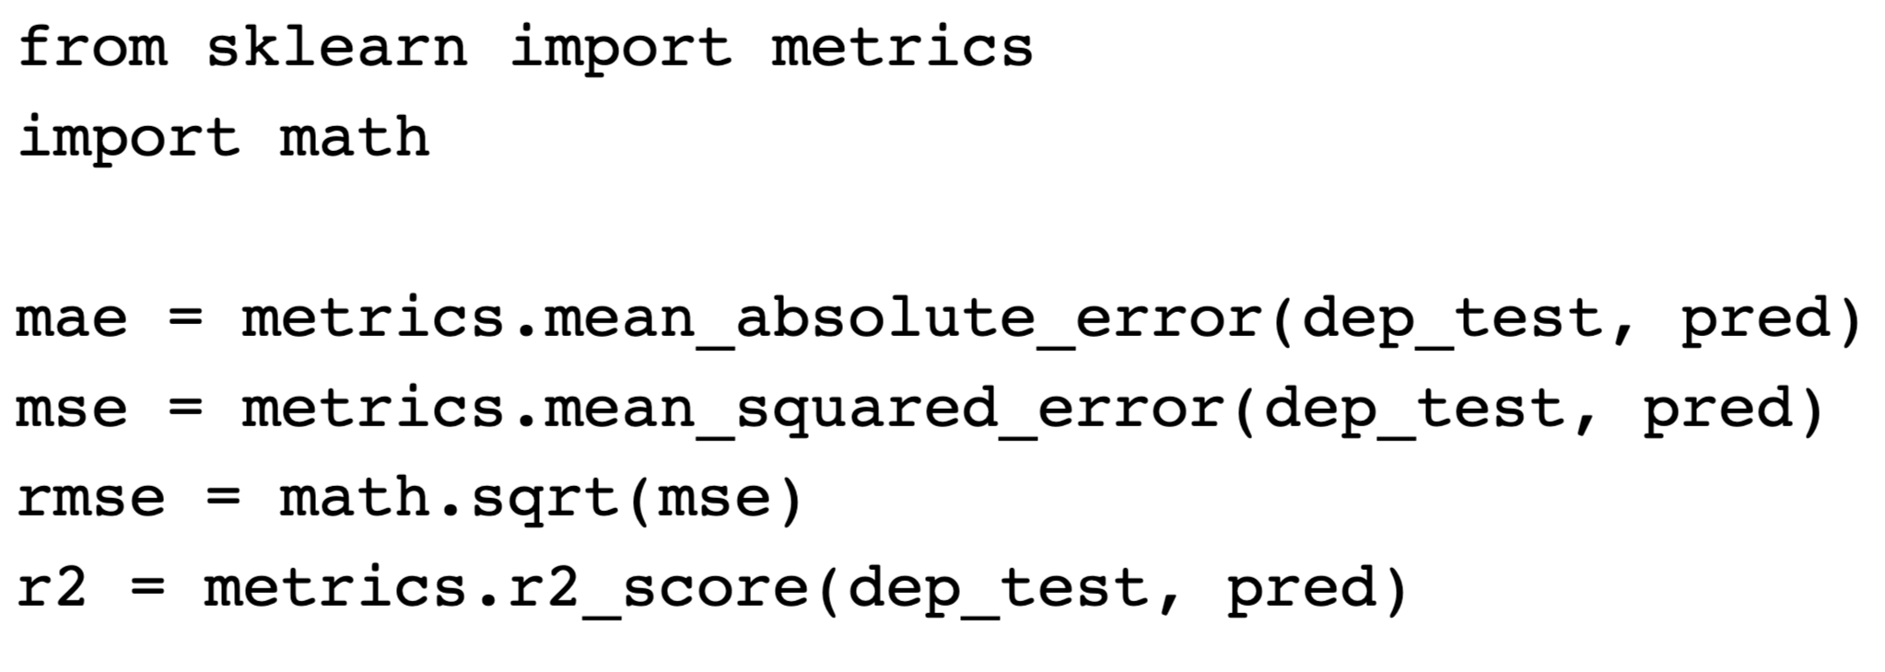
Regression Metric Calculation

Slide 12
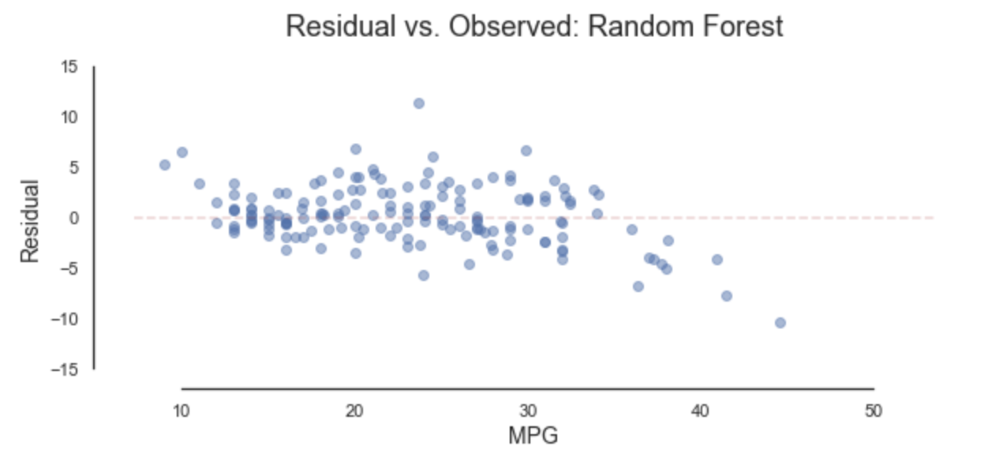
Residual vs. Observed Plot

Slide 13
Classification Evaluation Metrics I
Linden Lu

Slide 14
Classification Evaluation Metrics
Accuracy Score
Classification Report
Confusion Matrix

Slide 15
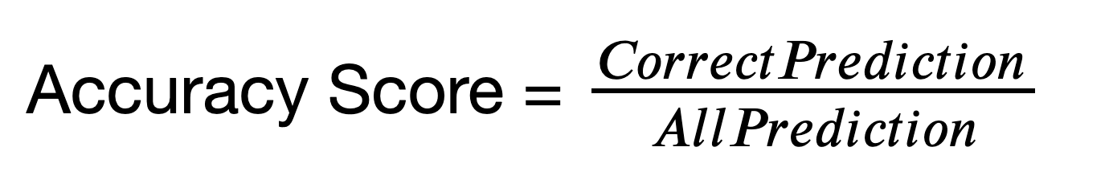
Accuracy Score

Slide 16
Imbalanced Dataset
Cancer screening test dataset
99% negative
1% positive
Zero model accuracy: 99%

Slide 17
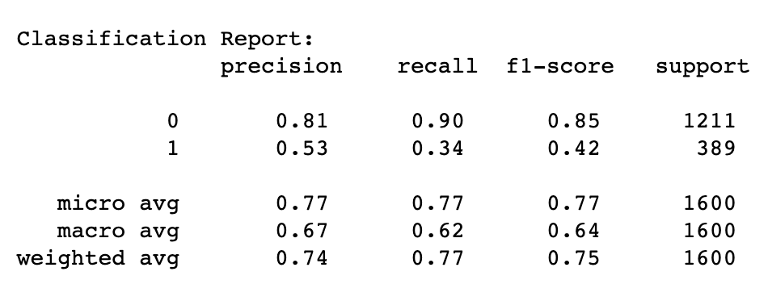
Classification Report
Precision: The proportion of the prediction that is correct
Recall: Proportion of actual class that is predicted correctly

Slide 18
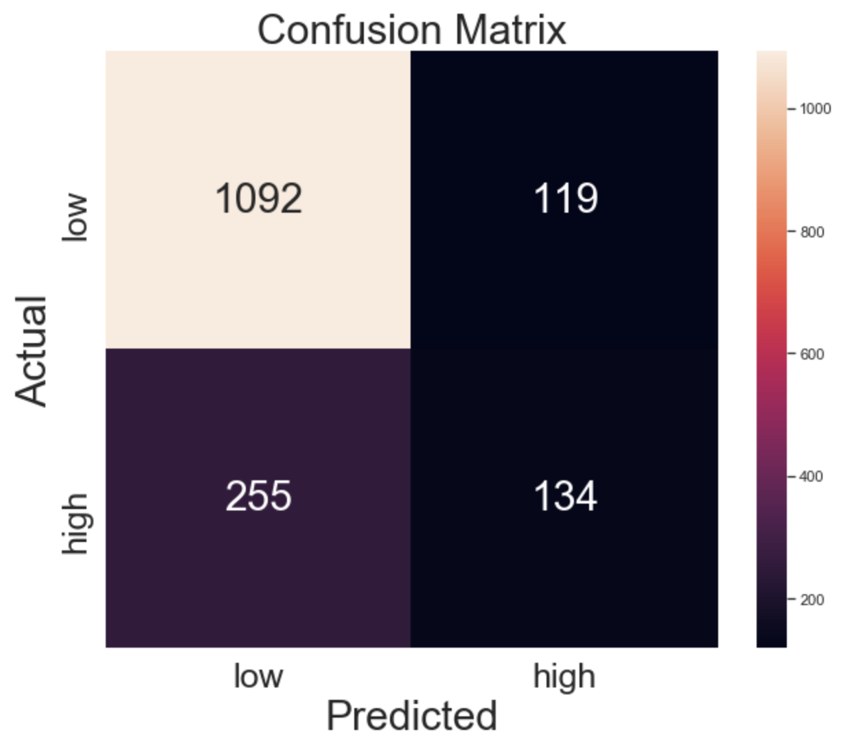
Confusion Matrix

Slide 19
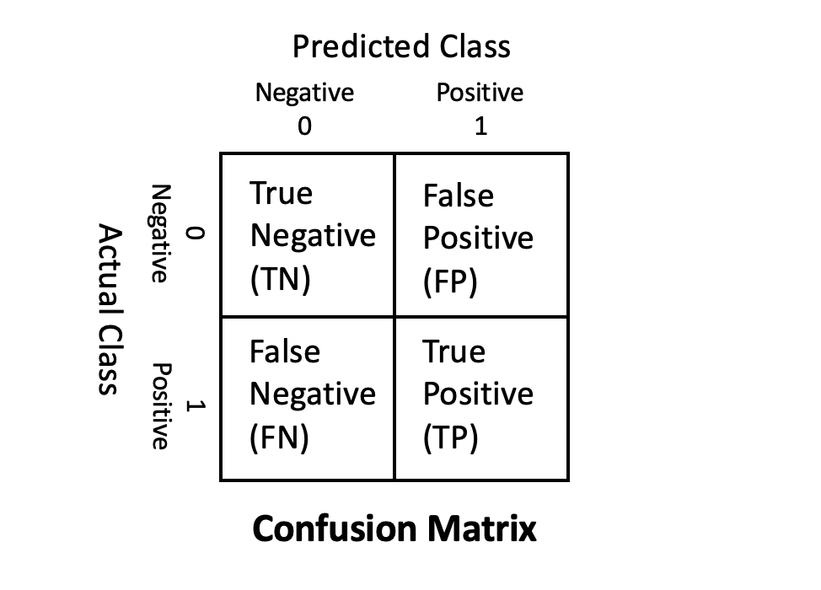
Confusion Matrix
True Negative (TN)
Total number of predicted negatives that are actually negative
False Negative (FN) a.k.a. Type 2 Error
Total number of predicted negatives that are actually positive
True Positive (TP)
Total number of predicted positives that are actually positive
False Positive (FP) a.k.a. Type 1 Error
Total number of predicted positives that are actually negative

Slide 20
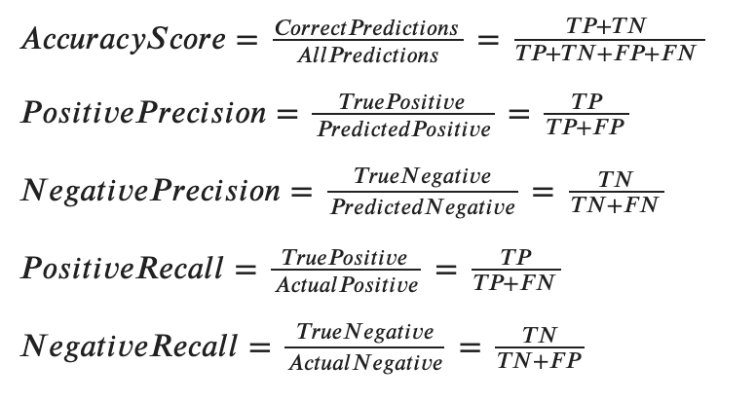
Metrics Calculation

Slide 21
Type 1 and Type 2 Errors
When to avoid Type 1 error (false positive)
Criminal trial
When to avoid Type 2 error (false negative)
Cancer screening test

Slide 22
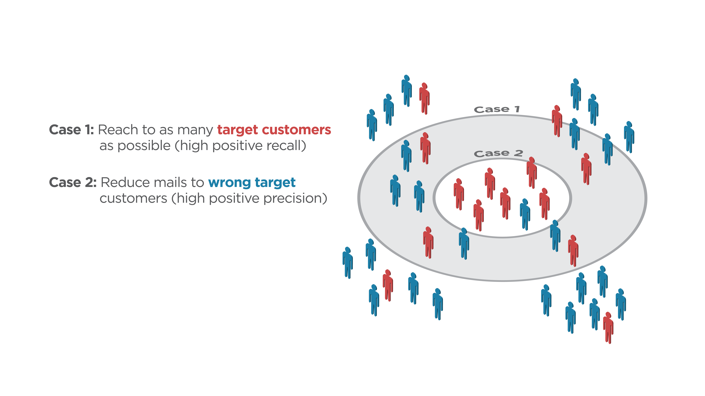
Classification Case Study: Direct Mail Marketing

Slide 23
Adjust class_weight Hyperparamter
class_weight
None (default):
Gives all classes same weight
Balanced
Gives weights inversely proportional to class frequencies
Custom weight
class_weight = {0:0.8, 1:0.2}

Slide 24
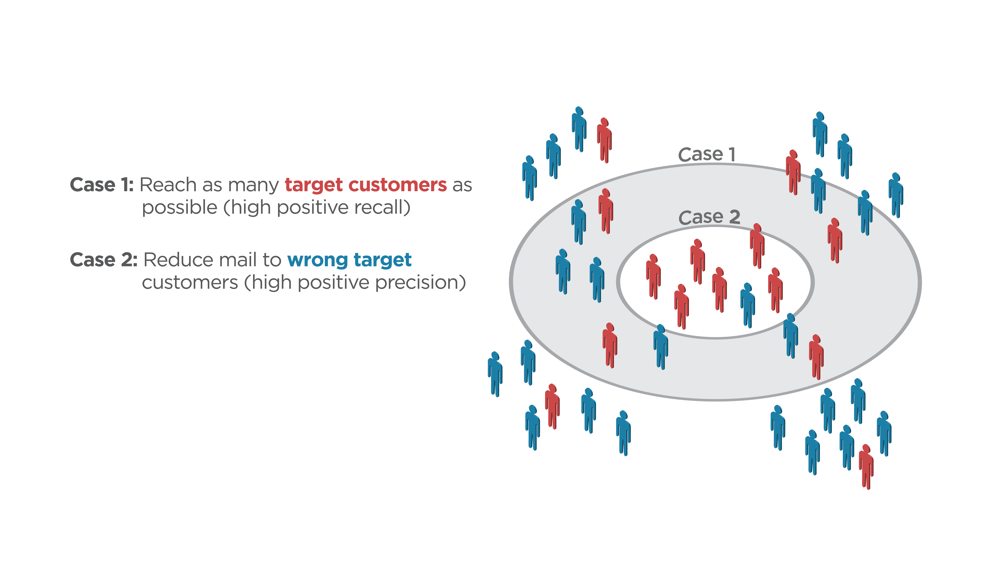
Classification Case Study: Direct Mail Marketing
Case 1: class_weight = {0:0.25, 1:0.75}
Case 2: class_weight = {0:0.8, 1:0.2}

Slide 25
Classification Evaluation Metrics I
Linden Lu

Slide 26
Classification Evaluation II
ROC
Receiver operating characteristic
AUC
Area under curve

Slide 27
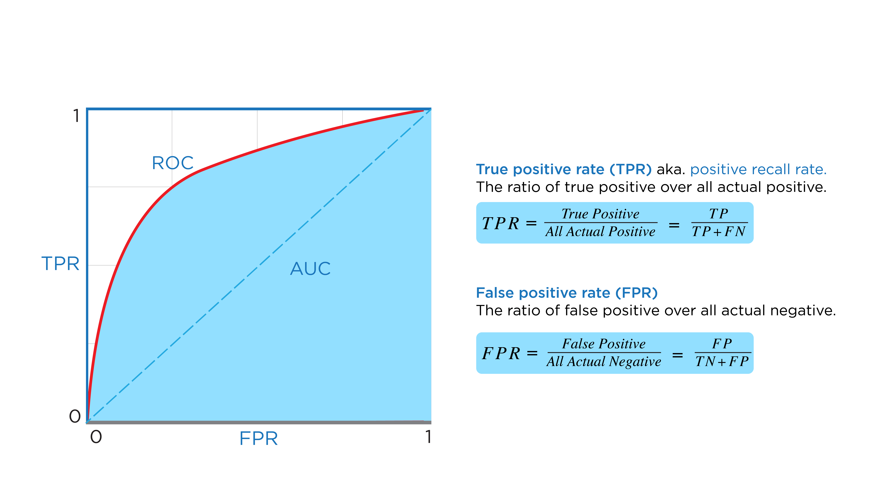
ROC & AUC

Slide 28
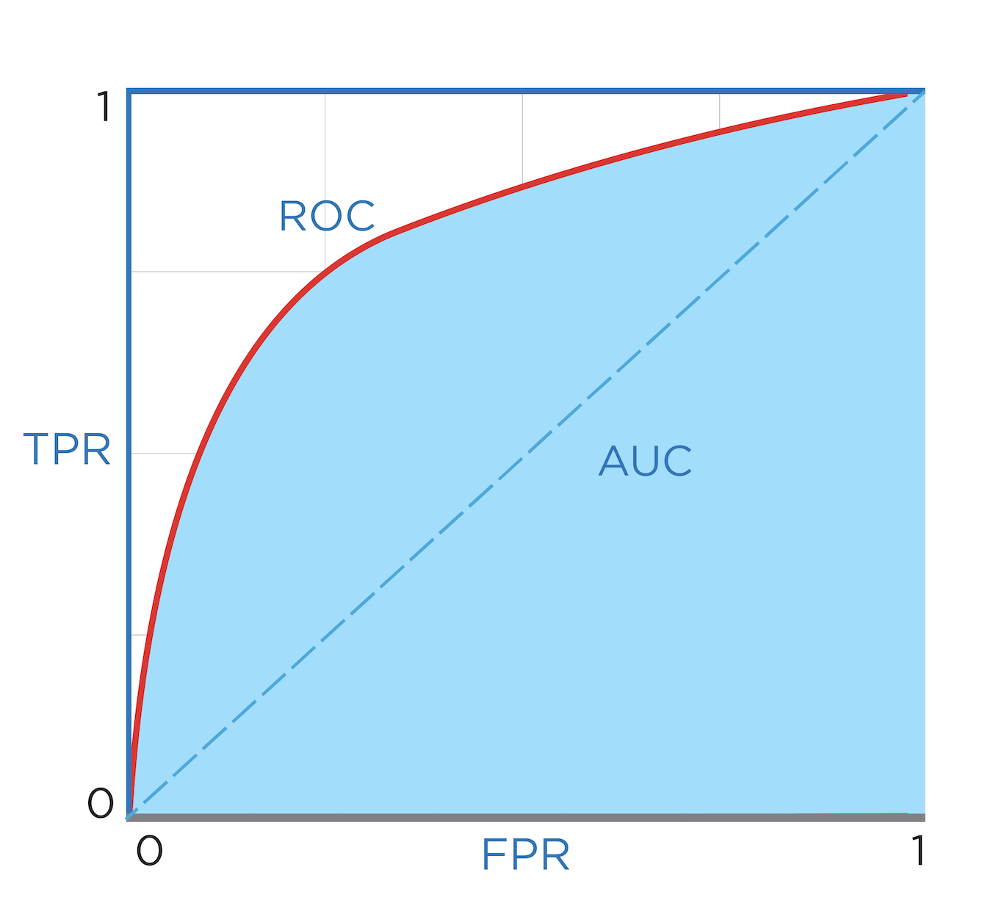
ROC – Random Model
Total:100 Positive:50 Negative:50
Random Model
Positive Predictions | TPR | FPR
0 | 0/50 = 0 | 0/50 = 0
10 | 5/50 = 0.1 | 5/50 = 0.1
20 | 10/50 = 0.2 | 10/50 = 0.2
80 | 40/50 = 0.8 | 40/50 = 0.8
100 | 50/50 = 1.0 | 50/50 = 1.0

Slide 29
ROC – Random Model
Total:100 Positive:50 Negative:50
Random Model
Positive Predictions | TPR | FPR
0 | 0/50 = 0 | 0/50 = 0
10 | 5/50 = 0.1 | 5/50 = 0.1
20 | 10/50 = 0.2 | 10/50 = 0.2
80 | 40/50 = 0.8 | 40/50 = 0.8
100 | 50/50 = 1.0 | 50/50 = 1.0

Slide 30
ROC – Random Model
Total:100 Positive:50 Negative:50
Random Model
Positive Predictions | TPR | FPR
0 | 0/50 = 0 | 0/50 = 0
10 | 5/50 = 0.1 | 5/50 = 0.1
20 | 10/50 = 0.2 | 10/50 = 0.2
80 | 40/50 = 0.8 | 40/50 = 0.8
100 | 50/50 = 1.0 | 50/50 = 1.0

Slide 31
ROC – Random Model
Total:100 Positive:50 Negative:50
Random Model
Positive Predictions | TPR | FPR
0 | 0/50 = 0 | 0/50 = 0
10 | 5/50 = 0.1 | 5/50 = 0.1
20 | 10/50 = 0.2 | 10/50 = 0.2
80 | 40/50 = 0.8 | 40/50 = 0.8
100 | 50/50 = 1.0 | 50/50 = 1.0

Slide 32
ROC – Random Model
Total:100 Positive:50 Negative:50
Random Model
Positive Predictions | TPR | FPR
0 | 0/50 = 0 | 0/50 = 0
10 | 5/50 = 0.1 | 5/50 = 0.1
20 | 10/50 = 0.2 | 10/50 = 0.2
80 | 40/50 = 0.8 | 40/50 = 0.8
100 | 50/50 = 1.0 | 50/50 = 1.0

Slide 33
ROC – Random Model
Total:100 Positive:50 Negative:50
Random Model
Positive Predictions | TPR | FPR
0 | 0/50 = 0 | 0/50 = 0
10 | 5/50 = 0.1 | 5/50 = 0.1
20 | 10/50 = 0.2 | 10/50 = 0.2
80 | 40/50 = 0.8 | 40/50 = 0.8
100 | 50/50 = 1.0 | 50/50 = 1.0

Slide 34
ROC – Perfect Model
Total:100 Positive:50 Negative:50
Perfect Model
Positive Predictions | TPR | FPR
0 | 0/50 = 0 | 0/50 = 0
10 | 10/50 = 0.2 | 0/50 = 0
50 | 50/50 = 1.0 | 0/50 = 0
60 | 50/50 = 1.0 | 10/50 = 0.2
100 | 50/50 = 1.0 | 10/50 = 1.0

Slide 35
ROC – Perfect Model
Total:100 Positive:50 Negative:50
Perfect Model
Positive Predictions | TPR | FPR
0 | 0/50 = 0 | 0/50 = 0
10 | 10/50 = 0.2 | 0/50 = 0
50 | 50/50 = 1.0 | 0/50 = 0
60 | 50/50 = 1.0 | 10/50 = 0.2
100 | 50/50 = 1.0 | 10/50 = 1.0

Slide 36
ROC – Perfect Model
Total:100 Positive:50 Negative:50
Perfect Model
Positive Predictions | TPR | FPR
0 | 0/50 = 0 | 0/50 = 0
10 | 10/50 = 0.2 | 0/50 = 0
50 | 50/50 = 1.0 | 0/50 = 0
60 | 50/50 = 1.0 | 10/50 = 0.2
100 | 50/50 = 1.0 | 10/50 = 1.0

Slide 37
ROC – Perfect Model
Total:100 Positive:50 Negative:50
Perfect Model
Positive Predictions | TPR | FPR
0 | 0/50 = 0 | 0/50 = 0
10 | 10/50 = 0.2 | 0/50 = 0
50 | 50/50 = 1.0 | 0/50 = 0
60 | 50/50 = 1.0 | 10/50 = 0.2
100 | 50/50 = 1.0 | 10/50 = 1.0

Slide 38
ROC – Perfect Model
Total:100 Positive:50 Negative:50
Perfect Model
Positive Predictions | TPR | FPR
0 | 0/50 = 0 | 0/50 = 0
10 | 10/50 = 0.2 | 0/50 = 0
50 | 50/50 = 1.0 | 0/50 = 0
60 | 50/50 = 1.0 | 10/50 = 0.2
100 | 50/50 = 1.0 | 10/50 = 1.0

Slide 39
ROC & AUC
AUC – Random Model = 0.5
AUC – Perfect Model = 1

Slide 40
Plot ROC
Classifiers that have decision_function():
Logistic Regression
Support Vector Machine
Classifiers that have predict_proba():
K-nearest Neighbors
Decision Tree
Random Forest

Slide 41
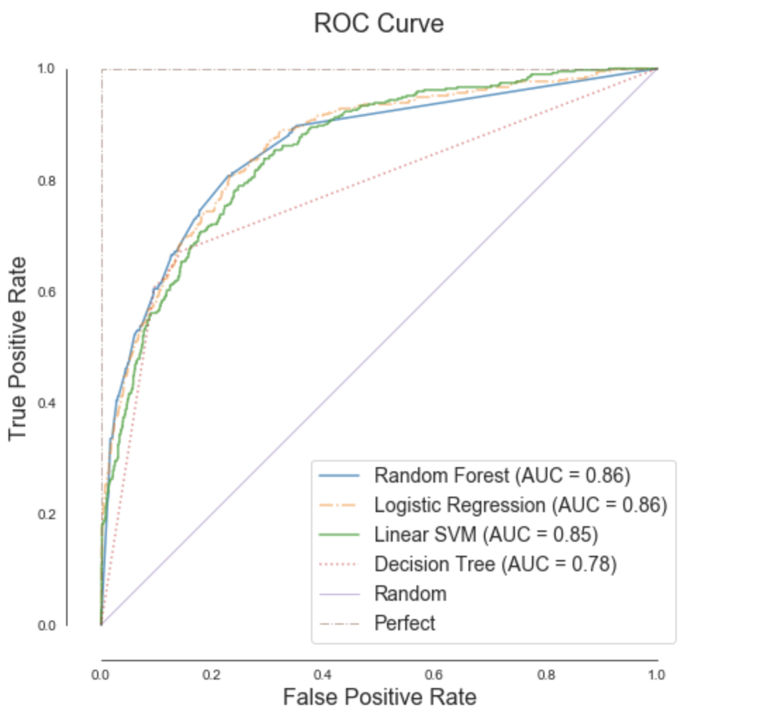
Compare Models with ROC & AUC

